Slide 1
Given at:
Job Hackers – SF 2020
The ROI of Learning Hour
by Llewellyn Falco
What the value in going to this conference?
You're here, you took time off work and paid real money to be here it safe to assume you see value in learning, but have you done the math?
The math turns out to be quite surprising, because it deals with systems involving compound interest.
Compound interest allows small changes to have **massive** effects over time.
Example 1:
Tim has a $100,000 loan at 100% interest. He pays **$8,333 a month**. At this rate it will take 50 years to pay off.
Allen has the same loan, but wants to pay it off **10 times** faster. How much more a month does he have to pay to achieve this?
Normal math would say 10 times is 8,333 X 10.
But the actual answer is just a mere seventy dollars more each month to bring the time down a factor of 10 times.
Surprizing? Yeah!
So come hear a combination of personal experiences and mathematical visualization explaining just how much you are getting out of doing a bit of learning everyday.
Example 2:
Team A works 8 hours a day.
Team B works 7 hours a day and spends 1 hour a day learning. This learning improves the team's output by 1%. How many days will it be until Team B has produced as much as Team A?
![Answer: 28 days](https://pbs.twimg.com/media/CS7U4EvWoAAtMmx.png:large)
Notes:
The ROI of Relentless Learning
by Llewellyn Falco
We are about to embark on a lot of learning hours.
But are they it worth it? Let’s do the math….
The math turns out to be quite surprising, because it deals with systems involving compound interest.
Compound interest allows small changes to have **massive** effects over time.
So come hear a combination of personal experiences and mathematical visualization explaining just how much you are getting out of doing a bit of learning everyday.

Slide 2
ToDo:
Talk about current time learning
Possible
Try a video hour…. Nordstrom Innovation Lab- Sunglass iPad App Case Study

Slide 3

ROI on Learning Hour
@LlewellynFalco

Slide 4
Resources
github.com/isidore/Talks/blob/master/RoiOnLearningHour.md

Slide 5
Push Ups

Slide 6


Slide 7
Habit

Slide 8
Trigger
Routine
Reward

Slide 9
Trigger
(game over)
Routine
(play again)
Reward
(not bored)

Slide 10
Trigger
(game over)
Routine
(do 1 pushup)
Reward
(not bored)

Slide 11
micro Habits after I ____ Then I ____

Slide 12
Starting Point ?

Slide 13
Important
&
Urgent
Important
but
Not Urgent
(Manage)
(Focus)
Important ➔
Not Important
but
Urgent
Not Important
&
Not Urgent
(Avoid)
(Limit)
⬅ Urgent

Slide 14
Important
&
Urgent
Important
but
Not Urgent
(I’m on it)
(When?)
Important ➔
Not Important
but
Urgent
Not Important
&
Not Urgent
(also on it)
(procrastination)
⬅ Urgent

Slide 15
Culture Norms

Slide 16
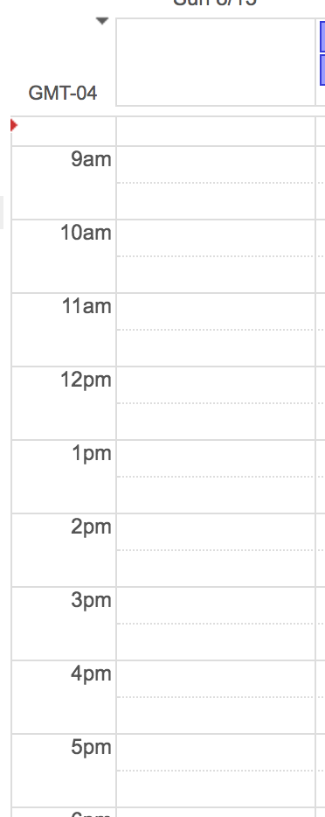
Mob w/ Team 1
Learning Hour
Lunch
Mob w/ Team 2
Mob w/ Team 3

Slide 17
Learning Hour

Slide 18
Koans
Katas
TDD (paired & mobbed)
Fake it till you make it
ApprovalTests
Combinatorial testing
Git
PowerPoint karaoke
Peel & Slice techniques
Functional Code Poke testing
Unit story writing
Video hour w/ lean coffee
Sparrow Decks
lfal.co/LearningHourTopics

Slide 19
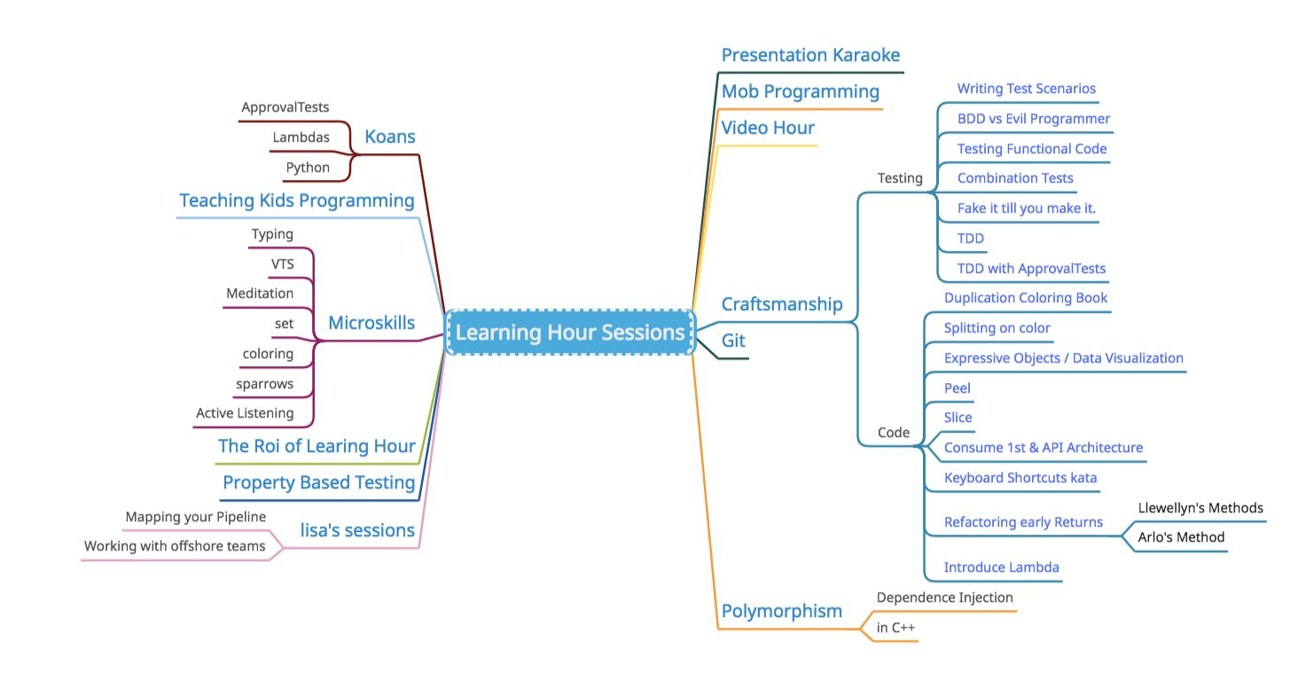

Slide 20
Small Gains over time
Important
but
Not Urgent
Important
but
Not Urgent

Slide 21


Slide 23



Slide 24


Slide 25
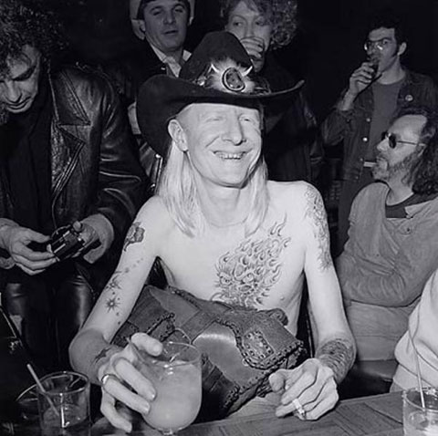
Johnny Winter’s manager had been slowly lowering his methadone dosage for 3 years without Johnny’s knowledge. As a result, Johnny was completely clean of his 40 year heroin addiction for over 8 months before being told he was finally drug free
*http://www.brooklynvegan.com/johnny-winter-r/

Slide 26
Small Gains over time

Slide 27

A swimming pool is not just a bigger bathtub
@LlewellynFalco

Slide 28
Bathtub
a tank or artificial basin filled with water

Slide 29
Swimming Pool
a large tank or artificial basin filled with water
larger

Slide 30

PoolPump

Slide 31

Swimming

Slide 32

Pool Party

Slide 33

Diving Board

Slide 34
Good Point!
Who Cares?

Slide 35
Virtual machine vs. Docker

Slide 36
Sprints Releases vs. Continuous Deployment

Slide 37
Test First vs. Test After

Slide 38
Mob w/ Team 1
Learning Hour
Lunch
Compound
Interest
Mob w/ Team 2
Mob w/ Team 3

Slide 39
Infinite TASKS

Slide 40
1
2
3
4
5
6

Slide 41
1/2 = .5 1/4 = .25 1/8 = .125 1/16 = .0625 1/32 = 0.03125 … 1/x = 0

Slide 42
SUPER TASKS

Slide 43
1
½
¼
1/8
1/16
1/32

Slide 44
1/1 = 1 [1] 1/2 = .5 [1.5] 1/4 = .25 [1.75] 1/8 = .125 [1.875] 1/16 = .0625 [1.9375] 1/32 = 0.03125 [1.96875] … 1/∞ = 0 [2]

Slide 45
1 (1) * .99 (1 * .99) * .99 = 1 * .99² (1 * .99 * .99) * .99 = 1 * .99³ (1 * .99 * .99 * .99) * .99 = 1 * .99⁴ … 1 * .99^{N}

Slide 46
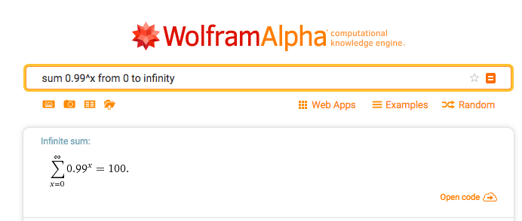

Slide 47
Compound Interest

Slide 48
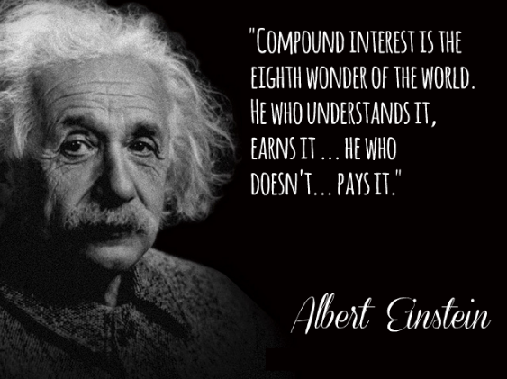

Slide 49
10 X

Slide 50
What does 10X look like?

Slide 51
$1 @ 10% interest For 1 Year
Total: $1.10
$1 @ 100% interest For 1 Year
Total: $2.00

Slide 52
$1 @ 10% interest For 20 Years
Total: $6.73
$1 @ 100% interest For 20 Years
Total: $1,048,576.00

Slide 53
Gross: $100,000 Gross: $145,000
Overhead: $95,000
($5K Profit)
($50K Profit)

Slide 54
Loan: $100,000 @ 10% interest $839 $2124
(50 years)
(5 years)

Slide 55
Interest: $100,000 @ 100% interest $8,333
(50 years)
$8,402
(5 years)

Slide 56
Person 1: $100 a Month for 17 Years
Person 2: $100 a Month for 17 Years

Slide 57
Person 1: $100 a Month for 17 Years
Person 2: $100 a Month for 17 Years

Slide 58
Person 1: $100 a Month for 17 Years
$530k
$53k
Person 2: $100 a Month for 17 Years

Slide 59
Unsurprisingly, the team did not achieve 10x productivity. In fact, we found our productivity to be almost the same as it was before…Your mileage may vary, but as far as we’re concerned it’s a resounding NO.
My Experience With MobProgramming
Is the product higher quality? Is there better test coverage? Is the code idiomatic and does it follow best practices? Are the chances of a bug crawling into the product minimized? From our experience this is the most emphatic YES of all the concerns listed above. Not only does having everyone together increase accountability and awareness, but mistakes that may be made by more junior developers are more likely to be caught. Furthermore, when our QA engineer was in the mob, he gained a much better sense of how to go about testing the feature as thoroughly as possible.
http://engineering.appfolio.com/appfolio-engineering/2014/03/17/my-experience-with-mob-programming

Slide 60
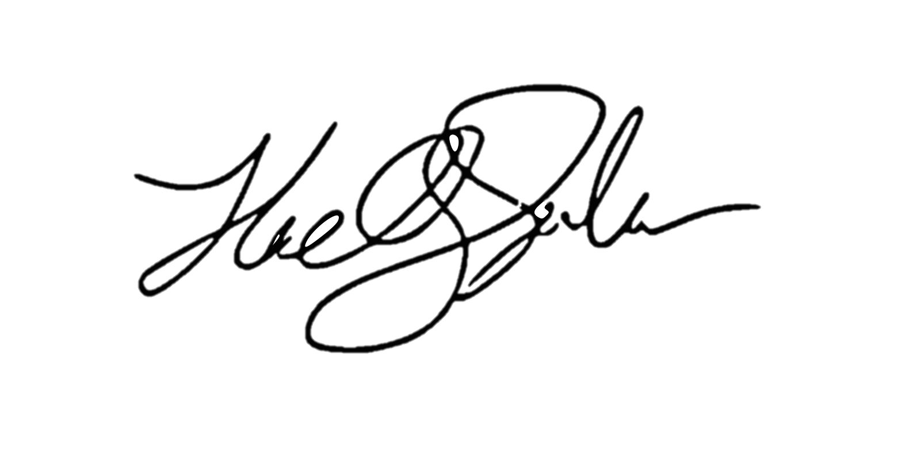
ROI of investing1 hour a day
for a 1% increase ( 5 minutes )
5x (1 year)
4x (10 months)
Output
2x (6 months)
3x (8.5 months)
28 days
Llewellyn Falco

Slide 61
1.00 ^ 365 = 1
1.01 ^ 365 = 37.78

Slide 62
How Much TIME can you spend LEARNING AT WORK?

Slide 63
1 hour
7 hour

Slide 64
4 hour
4 hour

Slide 65
6:45
1:15

Slide 66
Task board
To Do
Doing
Done

Slide 67


Task board
To Do
Doing
Done
Feature 1
Feature 2
Team
Improvement
Arlo Belshee
Ashley Johnson

Slide 68
Task board
To Do
Doing
Done
100%
(Features)
0%
(Improvements)

Slide 69
?%
(Features)
?%
(Improvements)

Slide 70
ROI MODELS of Learning http://lfal.co/LearningHour

Slide 71
Diminishing returns

Slide 72
Diminishing Returns

Slide 73
ABSOLUTE

Slide 74
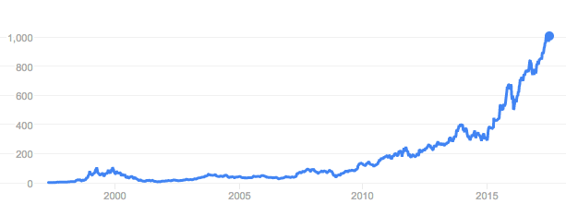
RELATIVE
3,138.38

Slide 75
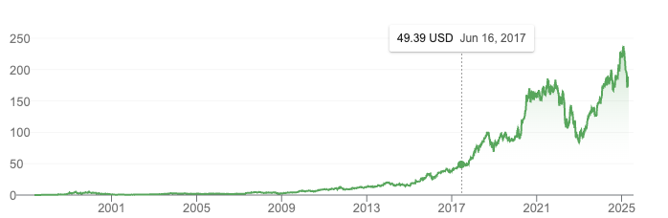
RELATIVE
3,138.38

Slide 76
Mob w/ Team 1
Learning Hour
Lunch
Benefits
Mob w/ Team 2
Mob w/ Team 3

Slide 77
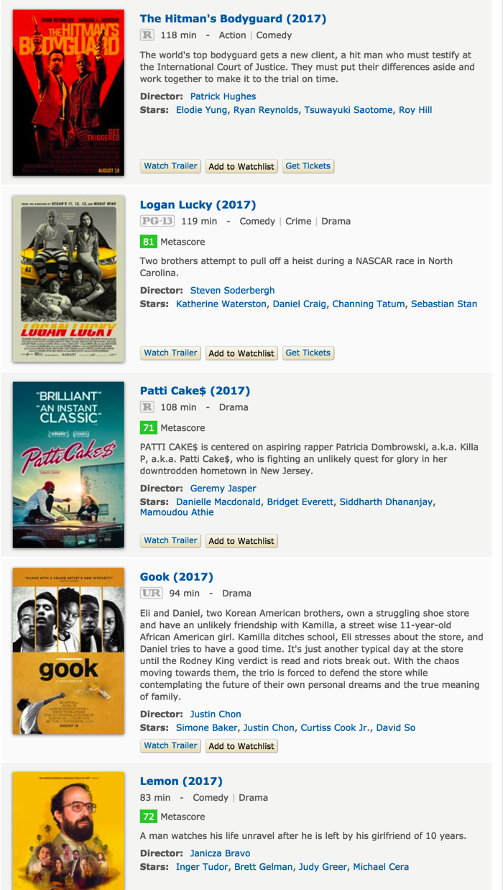
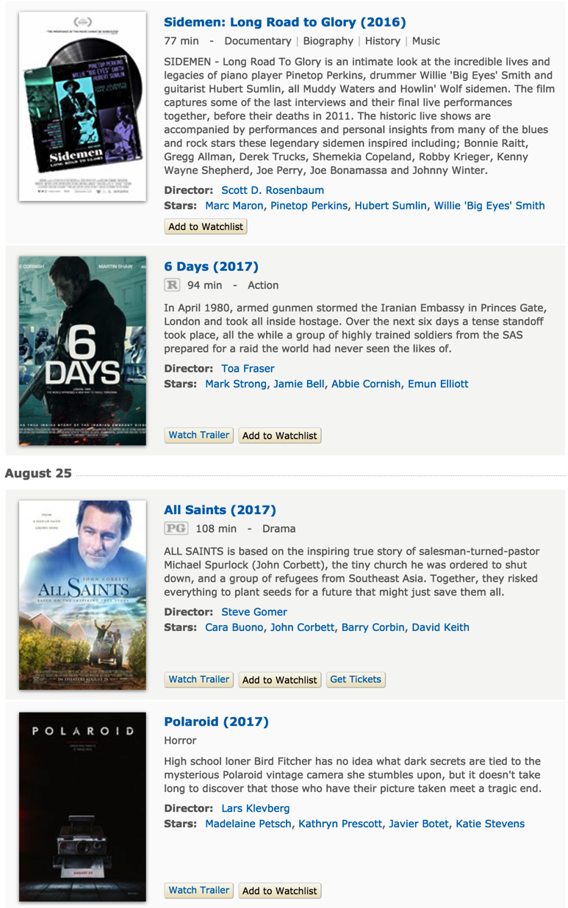

Slide 78
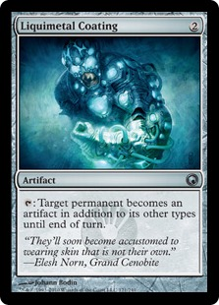
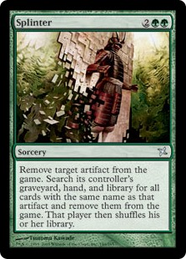
COMBOs

Slide 79
Passion

Slide 80
Passionate People Learning

Slide 81
Thresholds
* http://revisionisthistory.com/episodes/03-the-big-man-cant-shoot
Notes:
Wilt Chamberlain

Slide 82
Room Setup

Slide 83
Types of knowledge
PROFICIENCY
FLUENCY
AWARENESS

Slide 84
Lecture
Screen
Audience
Awareness

Slide 85
Mob
Screen
Laptop
White Board
Driver
Mob
(people rotate counter-clockwise every 4 mins)
Navigator
Facilitator
Audience
Proficiency

Slide 86
Pairs
Screen
Fluency

Slide 87
Workshop
Screen
Awareness
Proficiency
Fluency

Slide 88
a MICROSKILLS WEEK
Fluency

Slide 89


Slide 91
Returns on Learning

Slide 92
Machine Learning
?
time➔

Slide 93
Low Risk, Low Return

Slide 94
Existing Tools

Slide 95
Java Lambda’s
?
time➔
Existing Tools

Slide 96
New Tools

Slide 97
Spring Boot
?
time➔
New Tools

Slide 98
New Paradigms

Slide 99
Elixir
?
time➔
New Paradigms

Slide 100
High Risk, High Return

Slide 101
What does your Portfolio look like?

Slide 102
Important
&
Urgent
Important
but
Not Urgent
(Manage)
(Focus)
Important ➔
Not Important
but
Urgent
Not Important
&
Not Urgent
(Avoid)
(Limit)
⬅ Urgent

Slide 103
Retrospective

Slide 104
FEEDBACK

Slide 105
Pairing/Mobbing

Slide 106

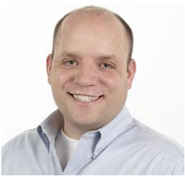
“If you want a learning culture, the first rule is:
you don't wait for after working hours
for learning to begin”
Ryan Ripley
#58 Agile Coaching Strategies

Slide 107
“The difference between
a Learning Hour and
a Meeting where you learn something
is that a learning hour would be useful to people who don’t work for your company”

Slide 108
ROI of investing1 hour a day
for a 1% increase ( 5 minutes )
5x (1 year)
4x (10 months)
Output
2x (6 months)
3x (8.5 months)
28 days
Llewellyn Falco

Slide 109
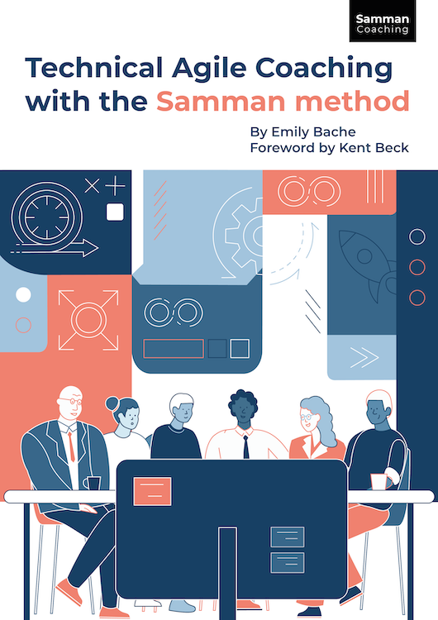
www.sammancoaching.org
Emily Bache

Slide 110
SPEND MORE TIME LEARNING AT WORK

Slide 111
Make LEARNING a REGULAR PART OF WORK

Slide 112
Review your retirement accounts

Slide 113
“The best time to plant a tree is 20 years ago.
The second-best time is now.”

Slide 114

Thank YOU (please connect via LinkedIn and Twitter)
@LlewellynFalco
youtube.com/isidoreus
LlewellynFalco.Blogspot.com approvaltests.com

